Slide 1




Online Group Ground Rules
Raise Hand
No Background Noise (TV, music, talking)
Arrive on Time
Attendance - Commitment

Slide 2
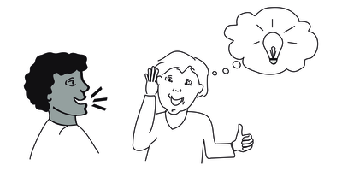


Online Group Ground Rules
5. Take Turns and Listen
6. Confidentiality
7. RESPECTFUL Exchange
8. Patience and Humor Appreciated

Slide 3
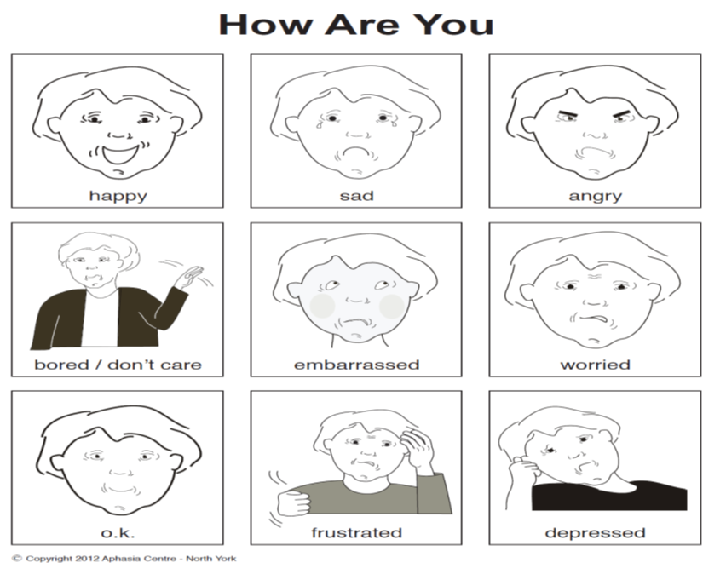

Online Group Ground Rules
9. Both Thoughts and Feelings Welcome--
Opportunity to Share or Pass
10. This is Your Group: Talk to Each Other
Notes:
Hopefully will have member to member interaction - asking each other questions and conversing together

